Slide 1
Happy Hour Project Presentation
September 11, 2019

Slide 2
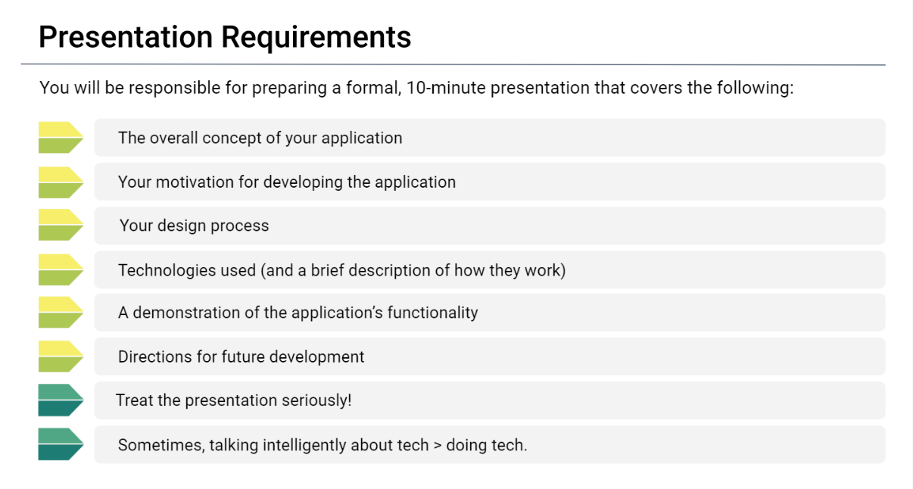

Slide 3
Overall Concept and Motivation:

Slide 4
Happy Hour Design Process Diagram
Start Program
Display the favorites on screen
Upload drink to Firebase
Listen for Submit Button
Display ingredients, measures and Favorites Button
Listen for Favorites Button
Search Cocktails DB for drink choice

Slide 5
Technologies Used
Technology
Firebase
Cocktail DB
Bootstrap
jQuery
JavaScript
HTML5
CSS3
Bootswatch

Slide 6

Technologies Used
Firebase

Slide 7
Demonstration:

Slide 8
Future Developments:

Slide 9
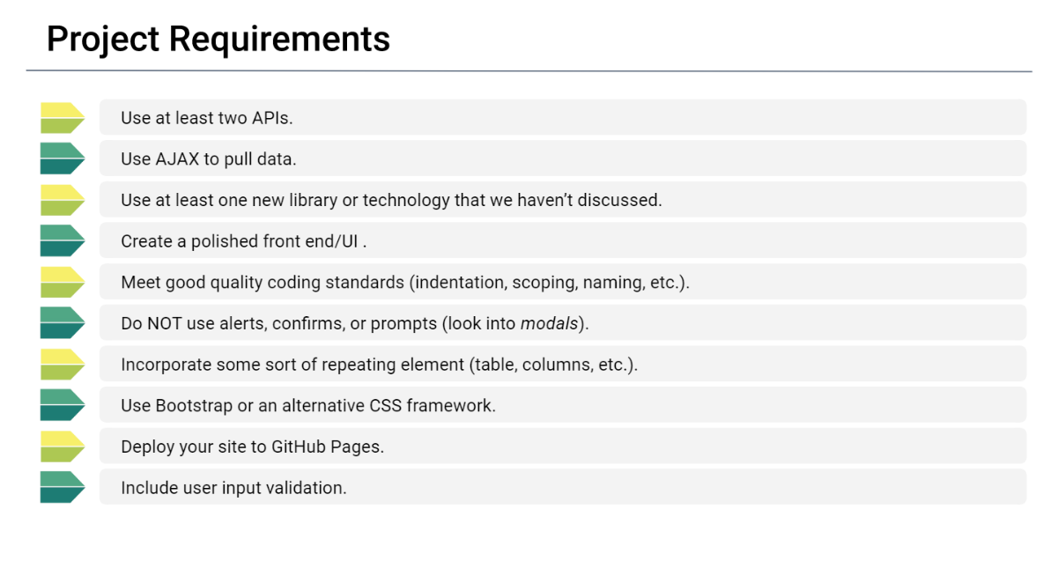


Slide 10
